Slide 1
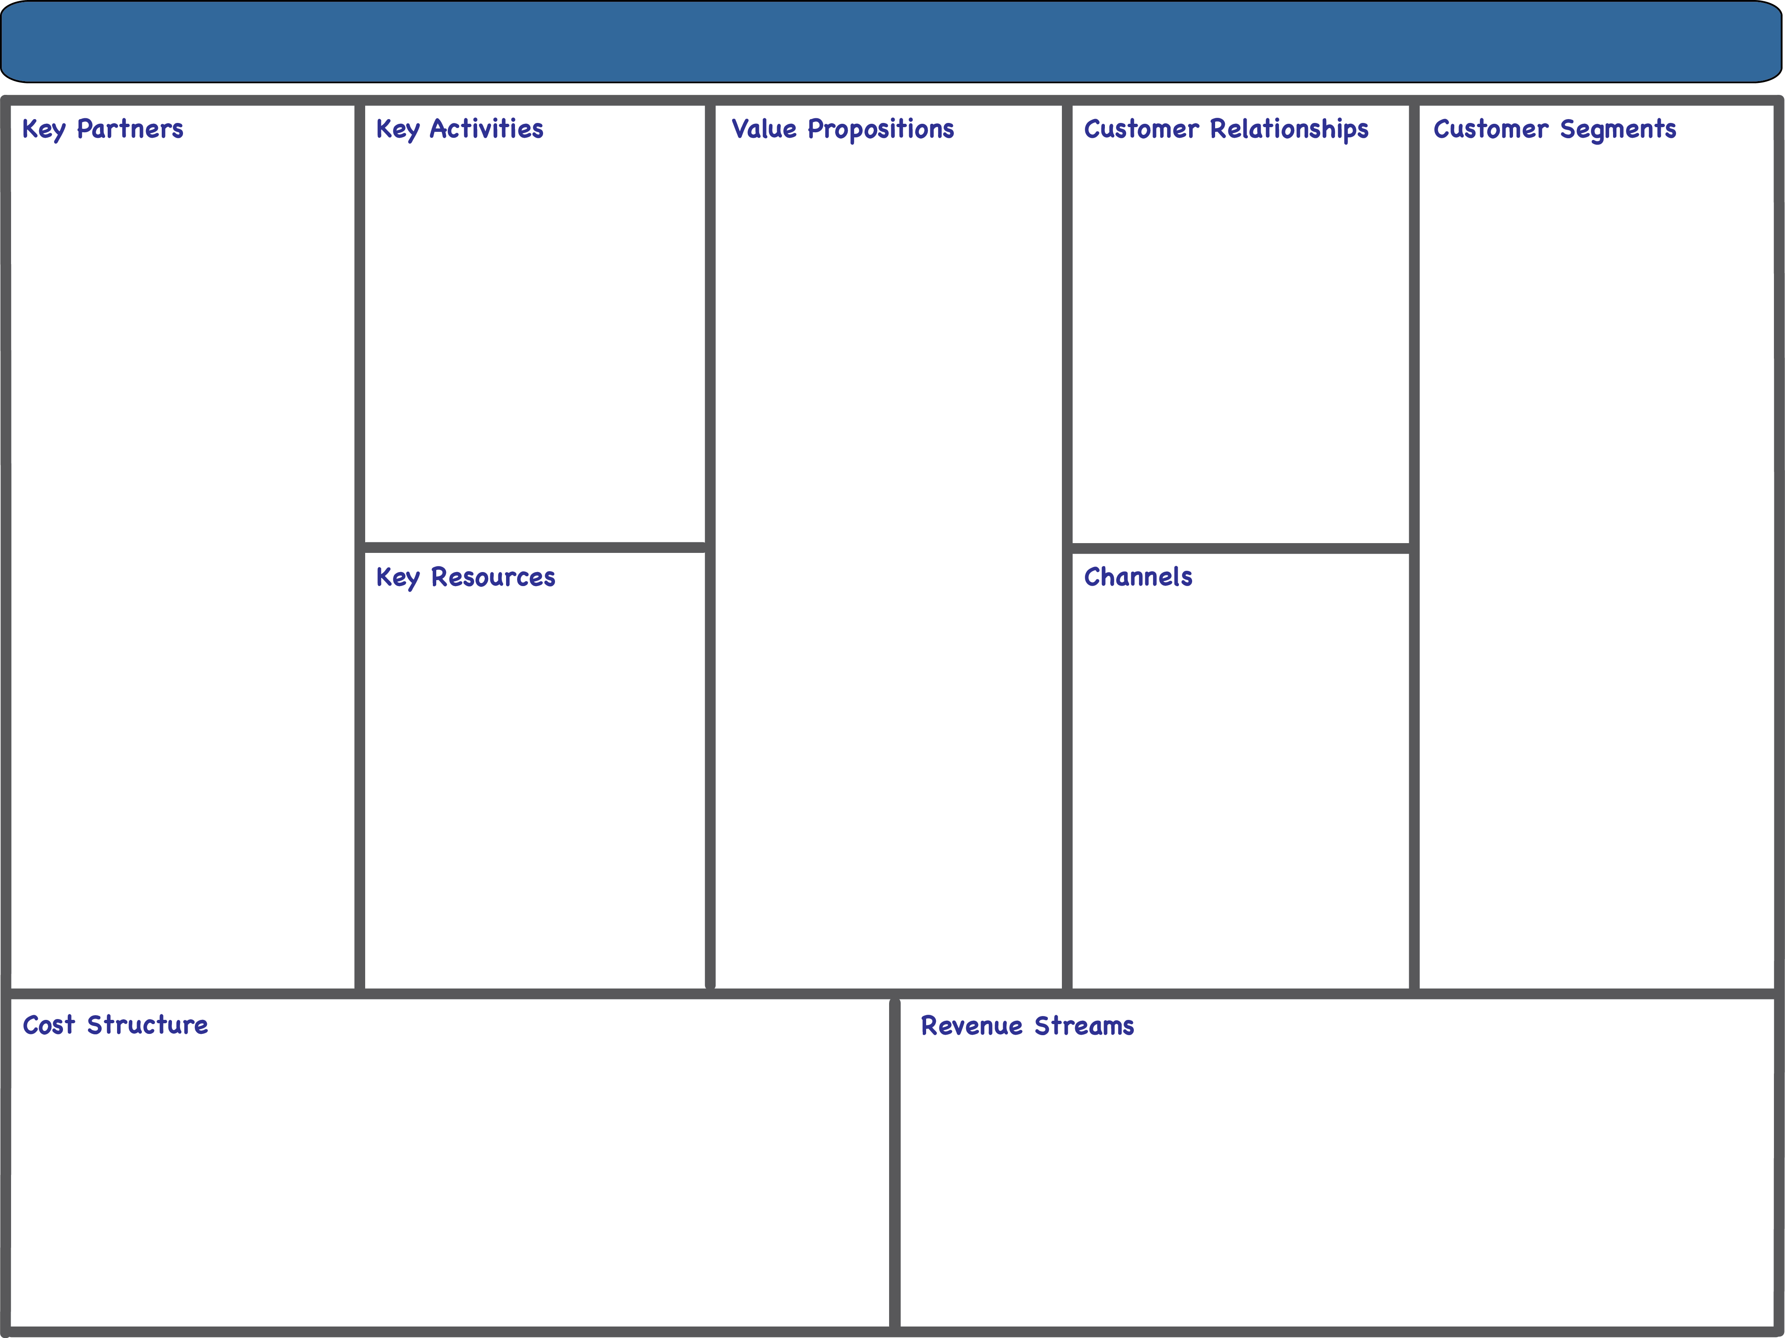

AIRBNB BUSINESS MODEL CANVAS
Payment Processing and Security
Marketing and Customer Acquisition
Ease of Transactions
For Hosts: Screened Guests
Customer Support
Online Self-Service
Payment Processors
Superhosts & Experienced Hosts
Minimize Risk
Platform Development & Maintenance
Risk Minimization
For Hosts: Management Tools
Community Forum
Issue Management
Investor & Commercial partners
Insurance Companies
Higher Education, Income
30-49 years old
Community Management
Safety/Security Measures
Content Creation and Curation
For Guests: Choice and Variation
For Guests: Amenities
Marketing Partners
Local Business
Consistent Guest Experience
Business & Luxury Travelers
Technology Providers
Tourism Partners
For Guests: Best Value
For Guests: Authentic Stay
Payment Processing Systems
Content
For Guests: Local Experience
Income Generation
Discounts/ Promotions
Marketing Channels
Business Travel Managers
Active Hosts and Guests
Airbnb platform
Website and Mobile App
Referral Programs
Ease of Getting Started
Business & Luxury Travelers
User Data
Word-of-Mouth from Host/Guest Interactions
Algorithm
Social Media
Brand Reputation
Leisure Travelers
Acquisition
Payment Processing Fees
Insurance
Marketing & Customer Acquisition
Research & development
Sales & Marketing
General and Admin
Host Fees
Guest Fees
Commissions on Transaction Values
Premium Listing
Experience Fees

